Slide 1
Detection of APT Malware through External and Internal Network Traffic Correlation
By Terence slot

Slide 2

Content
Introduction
APT Forensics
Forcing Communication with C&C servers
Cross-referencing idea
The XCOM experiment
Prototype Malware (MOCX)
Challenges and Solutions
Conclusion

Slide 3
Introduction
Security Gap (Mandiant)
Goal: Detect latest APT malware
Solution: client-server detection software for detecting APT
Proof: Malware MOCX

Slide 4
APT Forensics
Definition of Advanced Persistent Threat (APT) (Mandiant)
Advanced (A)
Highly advanced hacking skills
Team of experts
Capable of creating own private exploits
Persistent (P)
Adversary passively remains hidden on network
Several backdoors for reentry.
Threat (T)
Stealing intellectual property
Disabling legitimate web services.

Slide 5
APT Forensics
The Anatomy of an APT (Phases)
Reconnaissance
Delivery
Exploitation
Operation
Data Collection
Exfiltration

Slide 6
APT Forensics
Other APT variations of threats
Insider Threat
Skip first 4 APT phases
48% of data breaches caused by Insider Threat in 2009
Industrialized Threat
Focused on fast monetizing
Stealing online bank credential or credit card info
Random large quantity of malware on large scale
Bring-Your-Own-Device Threat (BYOD)
Too tightly couples security measures
Employees deploy own mifi connection

Slide 7
APT Forensics
Initial attack vector
Spear-Phishing
Drive-by-download
Online Social Networking
Watering Hole attack
Longlining
Search engine poisoning

Slide 8
APT Forensics
Infection and stealthy techniques of rootkits
MBR Infection
Alternate Data Streams
Slack Space
Bad Sectors
Hidden Partition
Interrupt Hooks
Message Hooks
SSDT Hooks

Slide 9
APT Forensics
APT Evasive techniques
Zero-day exploit
Encrypted Network Communication
Exploitation of digital signatures
Drive-by-download evasion
Fast-Flux exfiltration
Avoid detection through network packet manipulation
Logic Bomb

Slide 10
APT Forensics
Detection method for APT attacks
Types of Intrusion detection systems
Signature-Based Intrusion Detection Systems
Anomaly Detection Systems
Passive and reactive systems
Host based intrusion detection systems
Statistical correlation techniques
Counter method for Drive-by-download (Spunge: DNS Analysis)
Tracking down Trojans
(fine-grained classifier based on Decision Tree and Naïve Bayes model)
Process Query System (Multiple Sensors Scanners)

Slide 11
APT Forensics
Defend techniques against APT
Email inspection
DNS-based Black hole List (DNSBL)
Sandboxing Applications

Slide 12
APT Forensics
Tracking Methods
Fast-flux tracing
Utilizing honeypots
Reverse engineering malware samples

Slide 13
APT Forensics
Summary on APT methods
Attacker Perspective
Attack Methods
Evasive Methods
Authoritive Perspective
Defend Methods
Tracing Methods

Slide 14
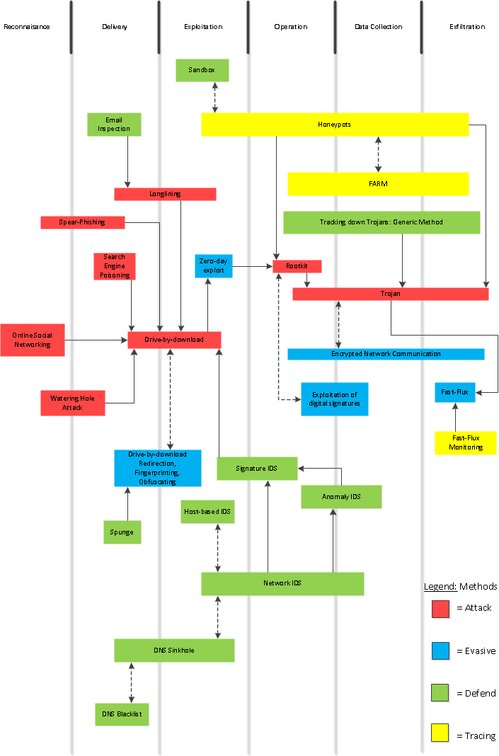

Slide 15
Forcing communication with C&C servers
APT Counter measures for sandboxed environments
4 categories of methods to detect Virtual Machine Environment (VME)
Look for VME artifacts in processes, file system, and/or registry.
Look for VME artifacts in memory.
Look for VME-specic virtual hardware.
Look for VME-specic processor instructions and capabilities.
Local time sources (Threads, Race condition)
Remote time sources (Response Time Website)

Slide 16
Forcing communication with C&C servers
APT malware samples
Careto (32/64 bit, MAC/OS, Linux, Spanish, high-valued targets)
IXESHE (60 C&C servers in US & China, internal network communication, Targets Asian companies)
Lurid (10 C&C server, targets russian countries)
Mirage (indefinitely retry connection, targets high-value companies)
Snake (similar to Careto, bypass patch guard, VFS in ADS, named-pipes)
Sykipot (Smartcard variant, anti-reverse eng. techs, uninstall feature)
Taidoor (old exploits, targets East-Asian countries, performs evasive tricks)
Winnti (Infects gaming companies, 32/64 bit, hides network connections)

Slide 17
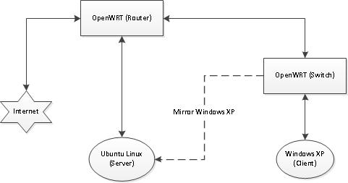
Forcing communication with C&C servers
APT malware samples that communicate to C&C servers
Wireshark Experiment
Network Architecture

Slide 18
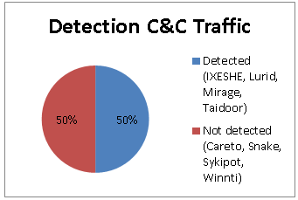
Forcing communication with C&C servers
APT malware samples that communicate to C&C servers
Results Wireshark Experiment

Slide 19
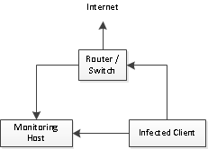
Cross-referencing idea
XCOM Network Architecture Sketch

Slide 20
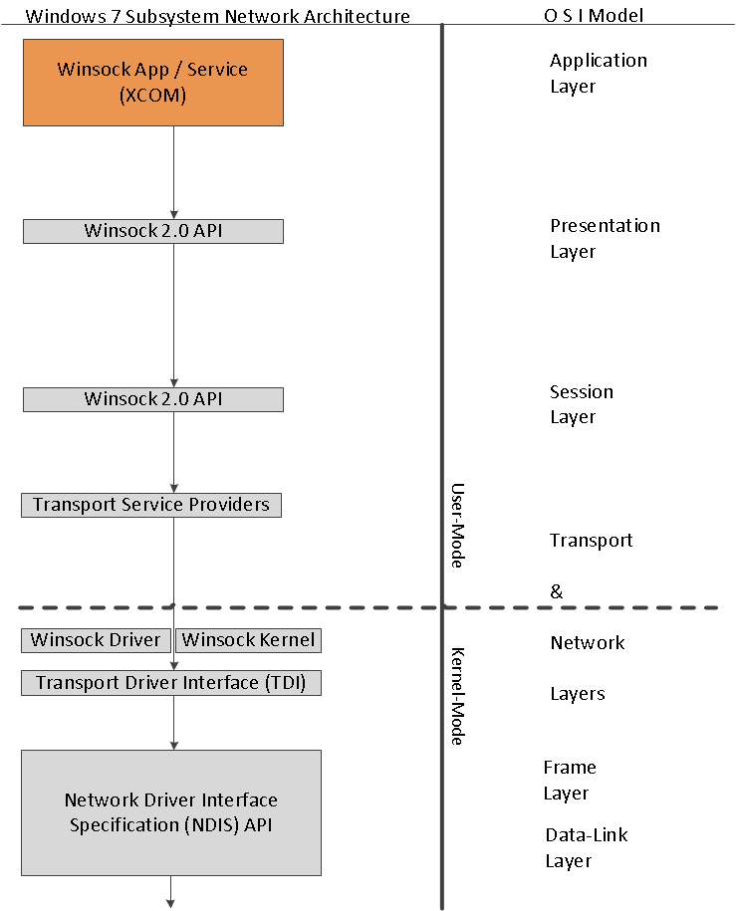
Cross-referencing idea
Windows 7 Network Subsystem Architecture

Slide 21
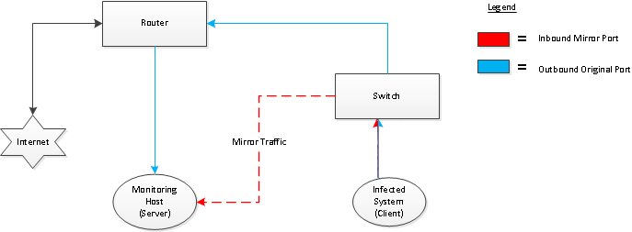
The XCOM experiment
XCOM Prototype Structure
Two applications
Server (Jpcap)
Client (windows socket 2 API, default)
Apache Thrift for communication

Slide 22
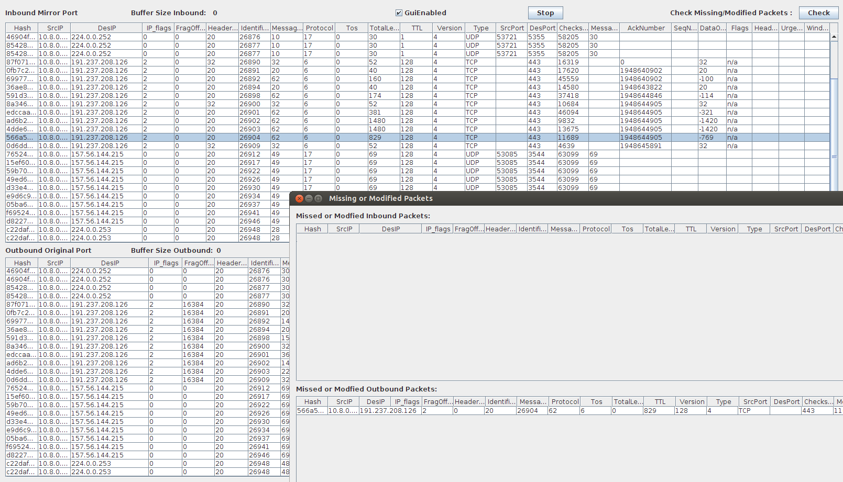
The XCOM experiment
XCOM Prototype Screenshot Server

Slide 23
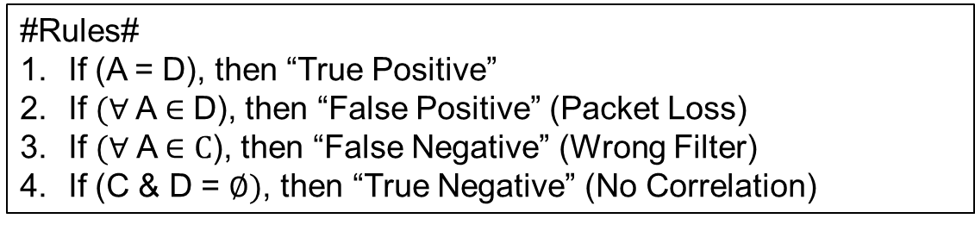
The XCOM experiment
XCOM Prototype Mechanism
Table corresponds with previous slide
A | C
B | D
#Legend#
A = Inbound packets from the mirror port.
B = Outbound packets encapsulated through the XCOM program.
C = Missed inbound packets.
D = Missed outbound packets.
#Rules#
If (A = D), then “True Positive”
If $(∀$A $∈$ D), then “False Positive” (Packet Loss)
If $(∀$ A $∈C$), then “False Negative” (Wrong Filter)
If (C & D = $∅)$, then “True Negative” (No Correlation)

Slide 24
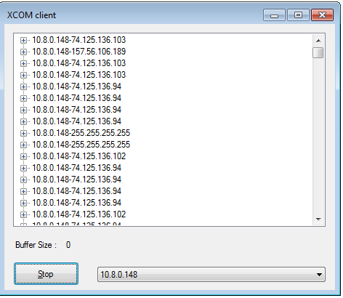
The XCOM experiment
XCOM Prototype Screenshot Client
Example Result Screen
(Does not correlate with
server screenshot)

Slide 25
Prototype Malware MOCX
MOCX Structure
Goal:
Create malware which will not get detected easily by conventional firewall solutions.
Core Feature:
Hide transmitted network packets.
Two versions:
WinPcap
WinDivert
Tested with:
Comodo Internet Security Suite
FortKnox Firewall
Outpost Security Suite
ZoneAlarm Security Suite

Slide 26
Prototype Malware MOCX
MOCX Result on Conventional Firewall Solutions
Result | Comodo Internet Security Suite | FortKnox Firewall | Outpost Security Suite | ZoneAlarm Firewall
WinPcap | U & A | U & A | U & B | U & B
WinDivert | U & A | U & A | D & (A | B) | U & B
Legend:
A = Activated
B = Blocked
U = Undetected
D = Detected
& = And
| = Or

Slide 27
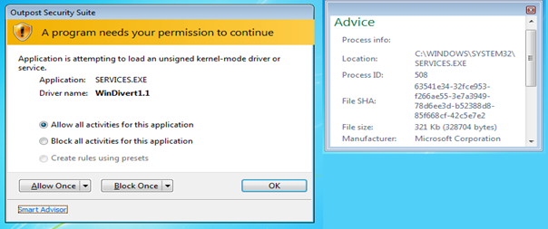
Prototype Malware MOCX
Interesting Result

Slide 28
Challenges and Solutions
Possible Future Improvements
Malware Samples
Correct malware sample
Logic bomb
Target specific system or network parameters
XCOM Detection Tool
Only inspect Destination IP (no other data)
Open flow
Integrate in existing IDS
Combine with OSSEC for authenticity
MOCX Prototype Malware
Steal digital signature and sign kernel mode driver
Hash collision with existing legitimate windows file

Slide 29
Conclusion
Summary
Defined APT.
Discovered most sophisticated APT named “Snake”.
Build virtual network environment with OpenWRT.
Performed manual Wireshark verification.
Build prototype detection tool.
Build prototype malware to proof XCOM prototype.
Tested malware with conventional firewall solutions.
Sourcecode released on github.

Slide 30
Questions?

